Slide 1
國立金門大學 智慧物聯網實務與應用 Ameba 8195AM 聲音視覺化
講師：曹永忠
國立金門大學-工業工程與管理學系
日期：106年6月24~25日

Slide 2
Arduino 程式介紹

Slide 3
Arduino 程式架構
2017/6/24
3

Slide 4
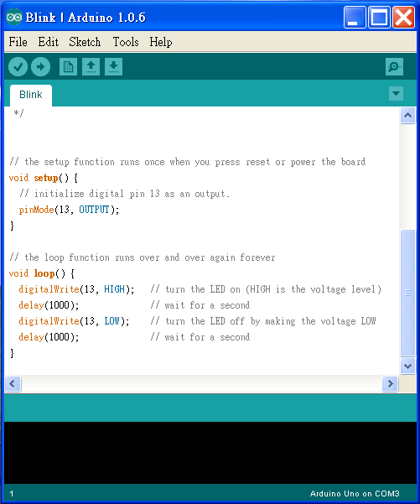
Arduino程式的介面
功能表

Slide 5
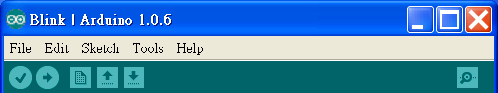
將程式燒入到
Arduino
開啟舊檔
回傳值
同等於C語言的Rebuild All
儲存檔案
開新檔案

Slide 6
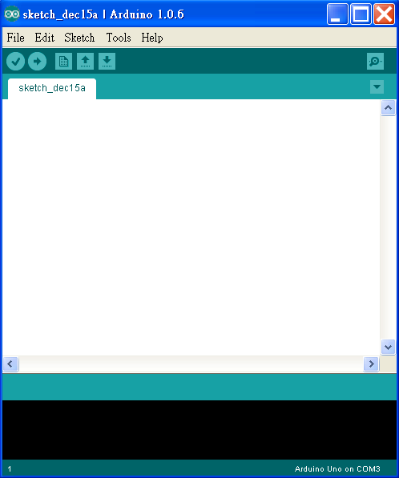
撰寫程式內容
要注意是否連線，
若未連線可以Rebuild但不可燒入

Slide 7
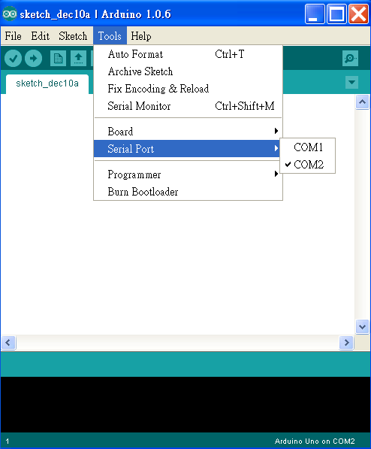
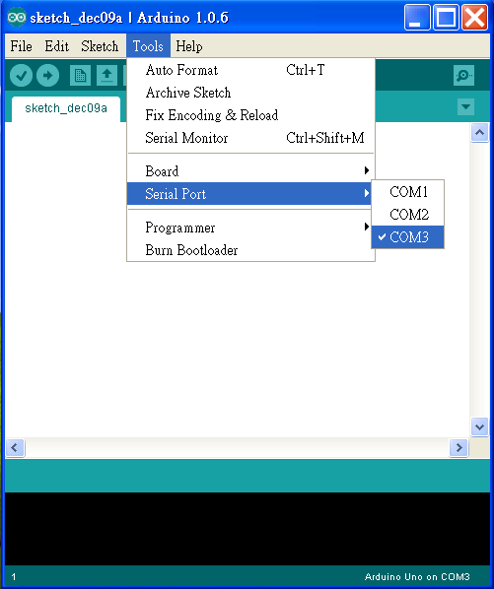
未連線
已連線

Slide 8
Arduino程式架構
(一.)宣告:
Arduino宣告方式與C相同,例如:int，float…
(二.)初始化 Setup():
使Arduino板子裝置妥當的指令
EX:
int ledPin=7; / 宣告Arduino7號腳為輸入腳/
Setup()
{
pinMode(ledPin,INPUT);
}

Slide 9
(三.)執行Loop():
為程式的主要內容,這程式內容會一直重複被執行
EX:
Loop()
{
……
}

Slide 10
(四.)函式:
1. pinMode(7,INPUT) //將腳位7設定為輸入模式
2. digitalWrite(8,HIGH) (數位腳專用)
//將腳位8設定輸出高電位
3. val=digitalRead(7) (數位腳專用)
//讀出腳位7的值並指定給 val變數

Slide 11
4.analogWrite(9,128) (數位訊號專用所設計的函式)
//將擁有PWM的數位腳位9 設定輸出電位2.5V對應值大 約為128
5. val=analogRead(0) (類比腳專用) //讀出腳位0的值並指定給 val變數(且analogRead可讀 取範圍0(0V)~1023(5V))

Slide 12
系統開發
2017/6/24
12

Slide 13
啟動開發環境
2017/6/24
13

Slide 14
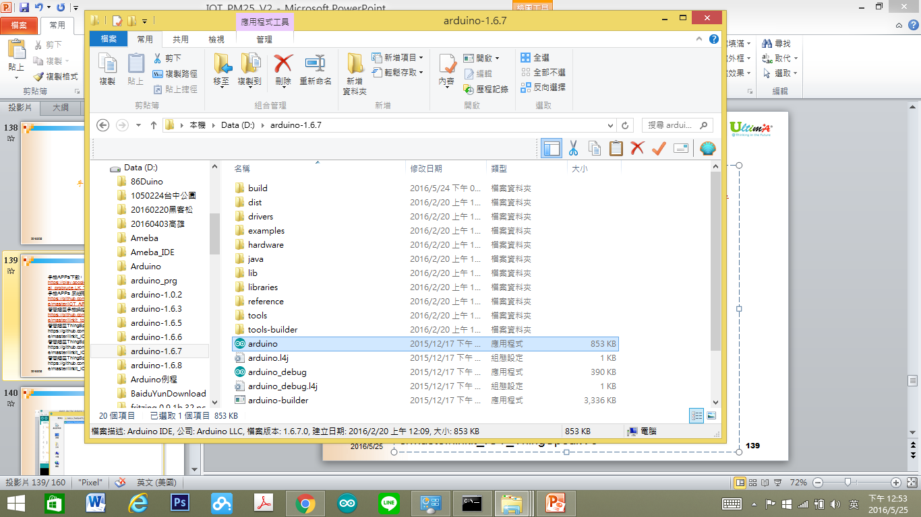
開啟程式
2017/6/24
14

Slide 15
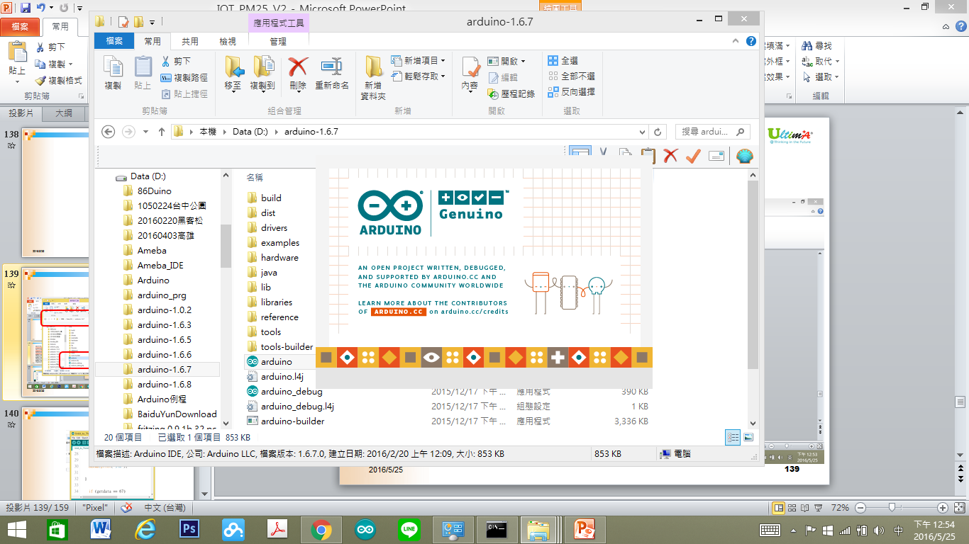
啟動程式
2017/6/24
15

Slide 16
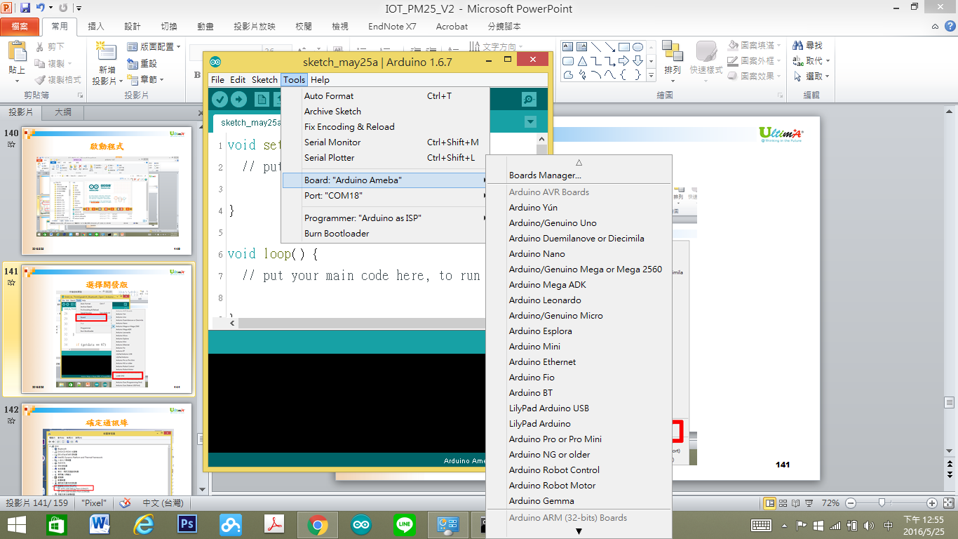
選擇開發版
2017/6/24
16

Slide 17
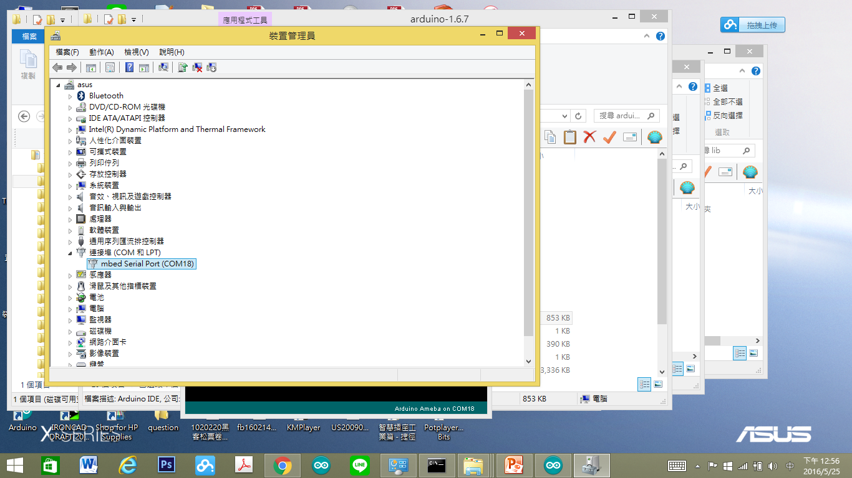
確定通訊埠
2017/6/24
17

Slide 18
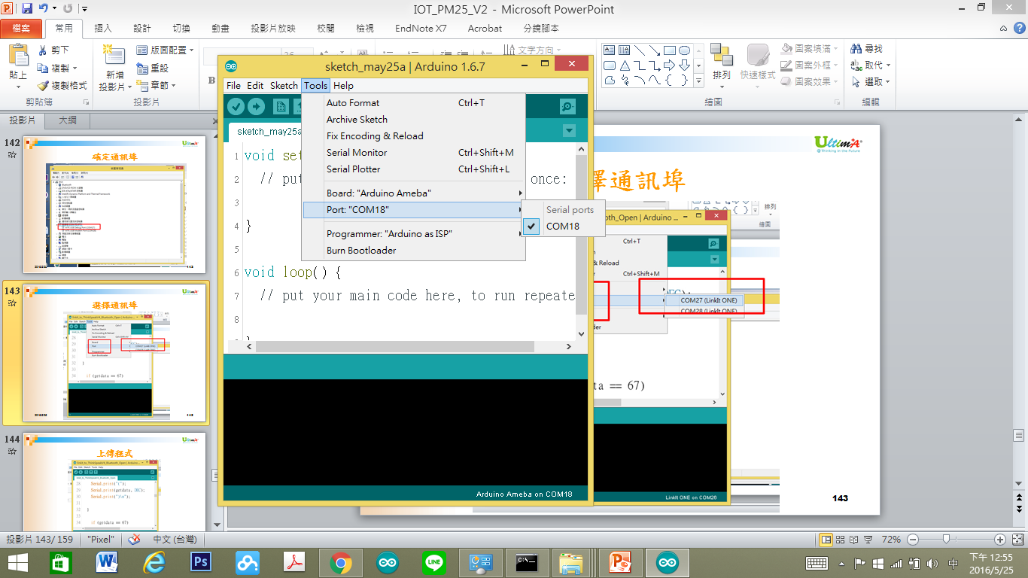
選擇通訊埠
2017/6/24
18

Slide 19
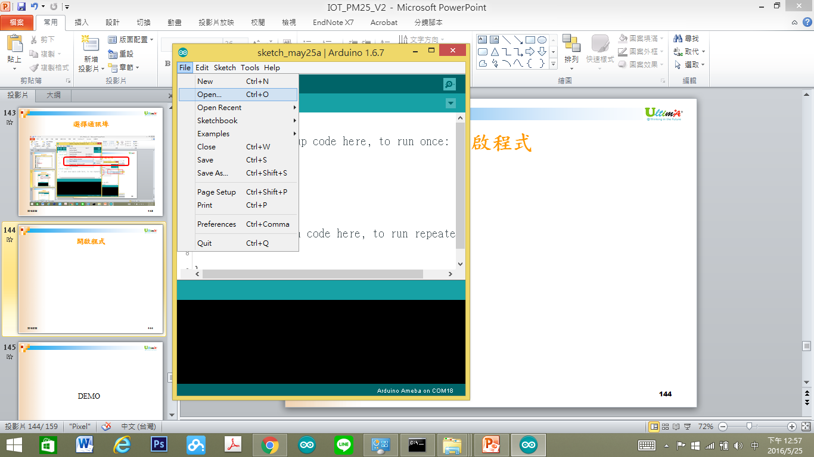
開啟程式
2017/6/24
19

Slide 20
Ameba 腳位說明
2017/6/24
20

Slide 21
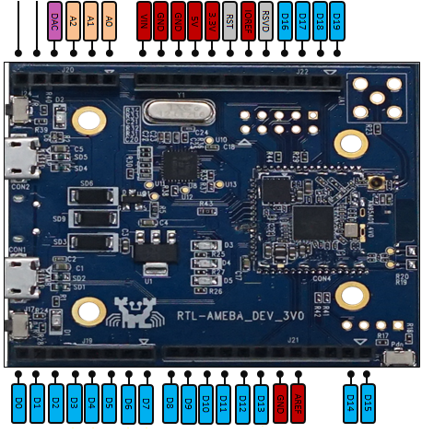
2017/6/24
21

Slide 22
聲音感測元件
2017/6/24
22

Slide 23
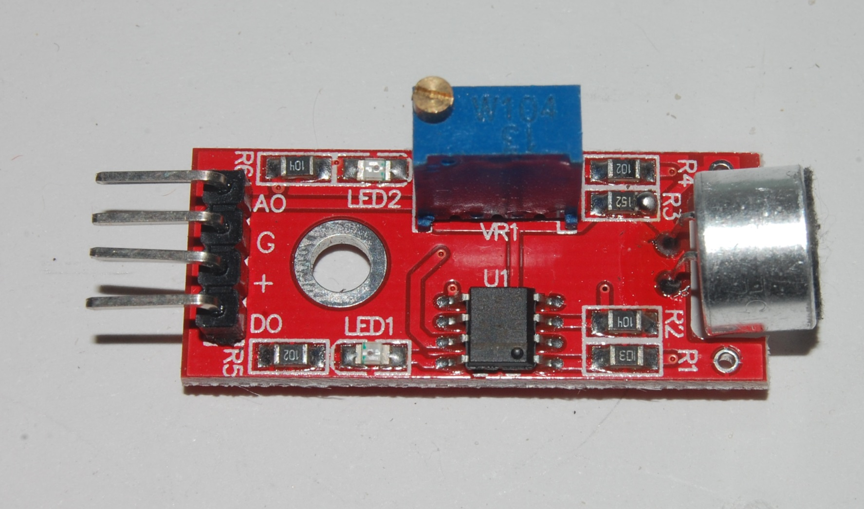
麥克風模組
2017/6/24
23

Slide 24
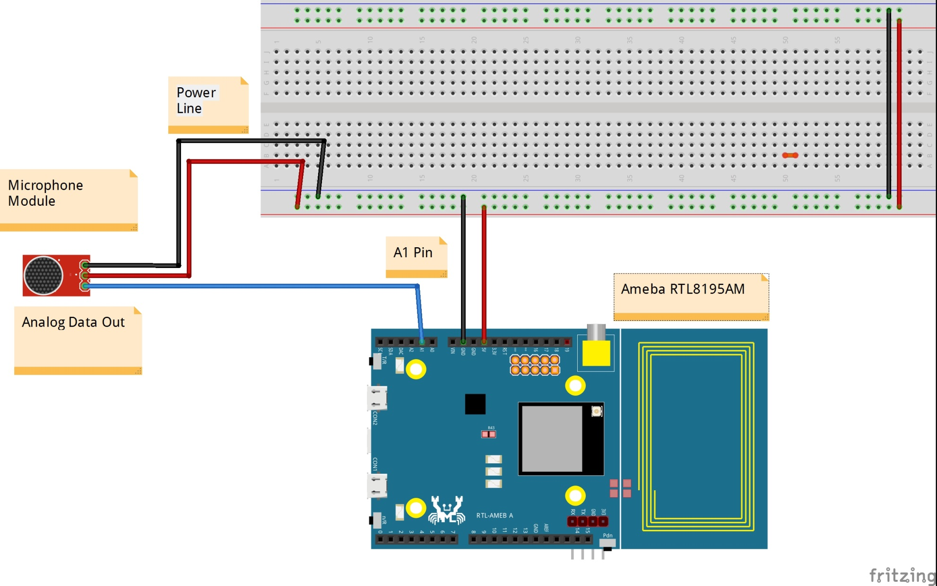
連接電路
2017/6/24
24

Slide 25
Coding
2017/6/24
25

Slide 26
讀取聲音資料
2017/6/24
26

Slide 27
WebServerShowNoise
#include <WiFi.h>
char ssid[] = "BruceSonyC5"; // your network SSID (name)
char pass[] = "12345678"; // your network password
// your network password
int keyIndex = 0; // your network key Index number (needed only for WEP)
int status = WL_IDLE_STATUS;
WiFiServer server(80);
2017/6/24
27

Slide 28
WebServerShowNoise
#define SoundPin 1
int SoundValue = 0;
int SoundValue1 = 0;
void setup() {
Serial.begin(9600); // initialize serial communication
// check for the presence of the shield:
if (WiFi.status() == WL_NO_SHIELD) {
Serial.println("WiFi shield not present");
while (true); // don't continue
}
2017/6/24
28

Slide 29
WebServerShowNoise
String fv = WiFi.firmwareVersion();
if (fv != "1.1.0") {
Serial.println("Please upgrade the firmware");
}
// attempt to connect to Wifi network:
while (status != WL_CONNECTED) {
Serial.print("Attempting to connect to Network named: ");
Serial.println(ssid);
2017/6/24
29

Slide 30
WebServerShowNoise
// Connect to WPA/WPA2 network. Change this line if using open or WEP network:
// status = WiFi.begin(ssid); //no pass
status = WiFi.begin(ssid, pass); //wpa use
// wait 10 seconds for connection:
delay(10000);
}
server.begin(); // start the web server on port 80
printWifiStatus(); // you're connected now, so print out the status
}
2017/6/24
30

Slide 31
WebServerShowNoise
void loop() {
SoundValue = analogRead(SoundPin) ;
SoundValue1 = map(analogRead(SoundPin),0,1023,0,100) ;
WiFiClient client = server.available(); // listen for incoming clients
if (client) { // if you get a client,
Serial.println("new client"); // print a message out the serial port
String currentLine = ""; // make a String to hold incoming data from the client
2017/6/24
31

Slide 32
WebServerShowNoise
while (client.connected()) { // loop while the client's connected
if (client.available()) { // if there's bytes to read from the client,
char c = client.read(); // read a byte, then
Serial.write(c); // print it out the serial monitor
if (c == '\n') { // if the byte is a newline character
// if the current line is blank, you got two newline characters in a row.
// that's the end of the client HTTP request, so send a response:
if (currentLine.length() == 0) {
// HTTP headers always start with a response code (e.g. HTTP/1.1 200 OK)
// and a content-type so the client knows what's coming, then a blank line:
2017/6/24
32

Slide 33
WebServerShowNoise
client.println("HTTP/1.1 200 OK");
client.println("Content-type:text/html");
client.println();
// the content of the HTTP response follows the header:
client.print("Now Noise is :(");
client.print(SoundValue);
client.print(") <br>");
// The HTTP response ends with another blank line:
client.println();
// break out of the while loop:
break;
2017/6/24
33

Slide 34
WebServerShowNoise
} else { // if you got a newline, then clear currentLine:
currentLine = "";
}
} else if (c != '\r') { // if you got anything else but a carriage return character,
currentLine += c; // add it to the end of the currentLine
}
// Check to see if the client request was "GET /H" or "GET /L":
}
}
// close the connection:
client.stop();
Serial.println("client disonnected");
}
}
2017/6/24
34

Slide 35
WebServerShowNoise
void printWifiStatus() {
// print the SSID of the network you're attached to:
Serial.print("SSID: ");
Serial.println(WiFi.SSID());
// print your WiFi shield's IP address:
IPAddress ip = WiFi.localIP();
Serial.print("IP Address: ");
Serial.println(ip);
// print the received signal strength:
long rssi = WiFi.RSSI();
Serial.print("signal strength (RSSI):");
Serial.print(rssi);
Serial.println(" dBm");
// print where to go in a browser:
Serial.print("To see this page in action, open a browser to http://");
Serial.println(ip);
}
2017/6/24
35

Slide 36
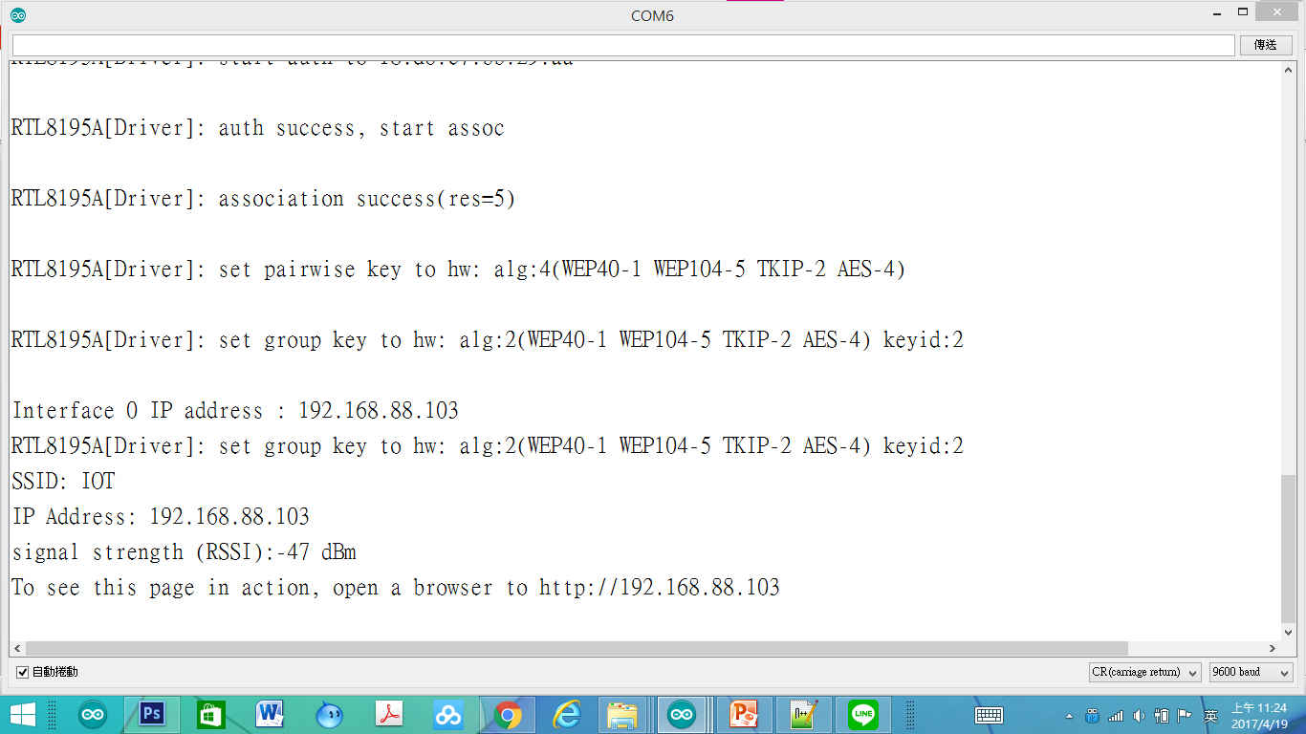
監控畫面
2017/6/24
36

Slide 37
使用瀏覽器進入系統
1.先使用筆電或手機，使用wifi，並將ＷＩＦＩ熱點連接到與Ameba相同的熱點
2.進入瀏覽器(建議使用chrome)
3.網址列輸入上面IP(本例子為：http://192.168.88.103/
2017/6/24
37

Slide 38
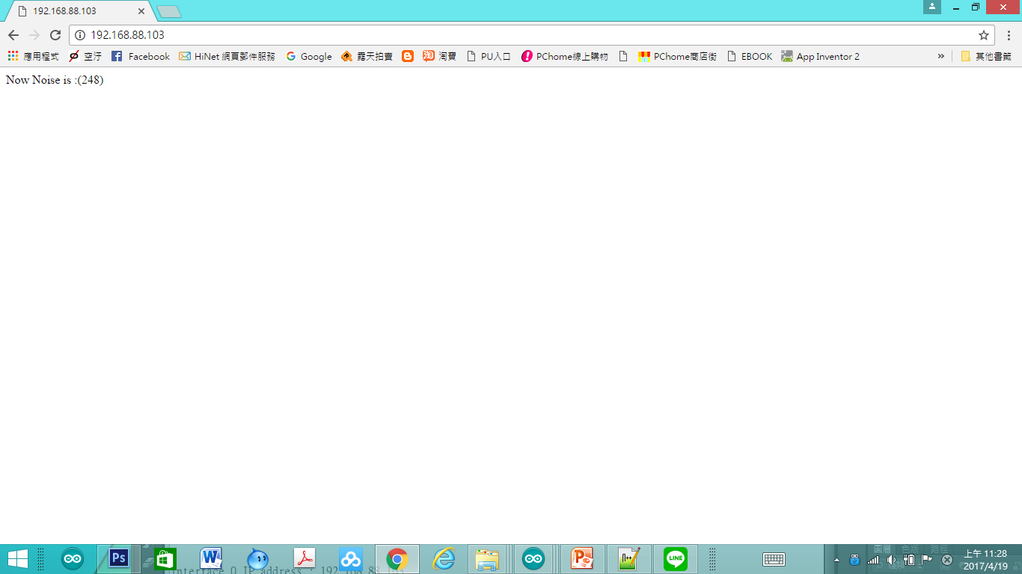
網頁畫面
2017/6/24
38

Slide 39
ScanNetworks 程式重點解說
#include <WiFi.h> 使用網路必要函數
WiFi.status() == WL_NO_SHIELD 檢查有網路供能否
WiFi.firmwareVersion();檢查網路韌體版本
listNetworks() 列出可連接到的AP(自訂)
WiFi.scanNetworks(); 取得可連接到的AP並存入(-1為沒有AP可連接)
WiFi.SSID(n) 可連接到的AP(n)的名字
WiFi.RSSI(n) 可連接到的AP(n)的RSSI
WiFi.encryptionTypeEx(n)可連接到的AP(n)的加密方式I
2017/6/24
39

Slide 40
如何視覺化
2017/6/24
40

Slide 41
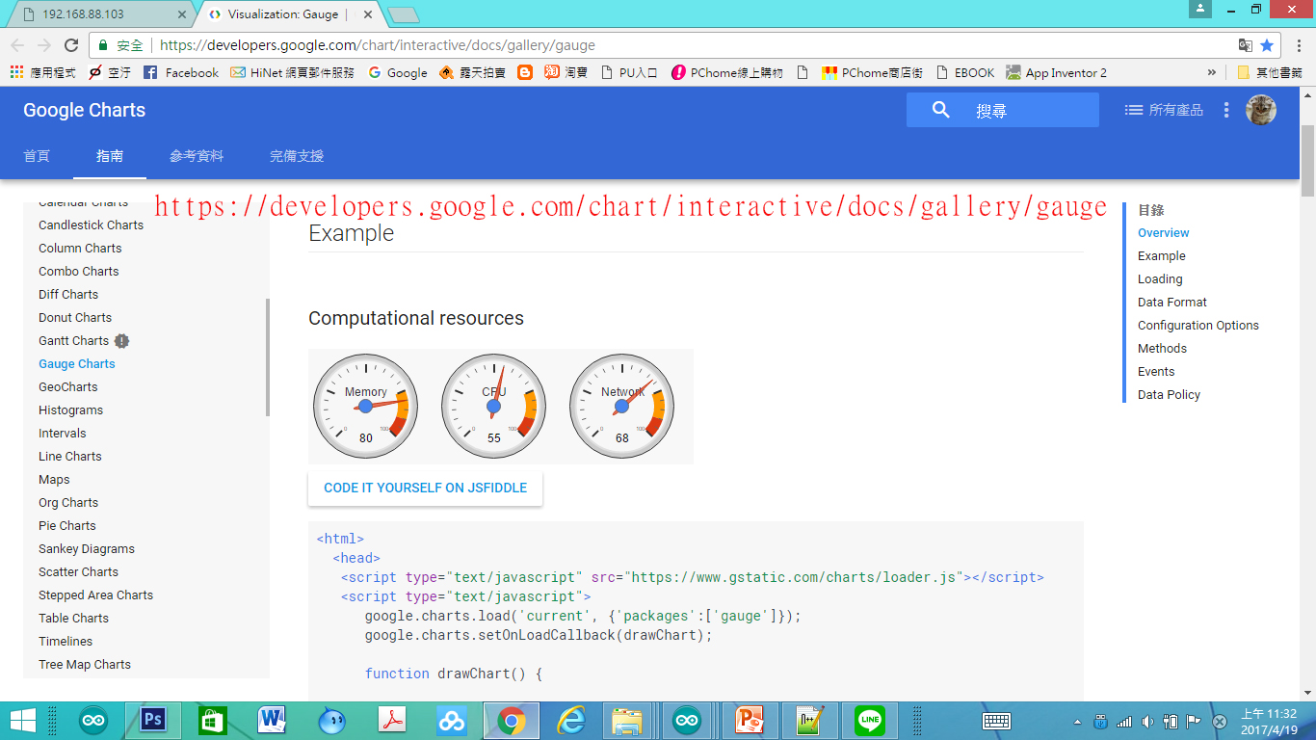
使用Google Developer資源
2017/6/24
41
Notes:
https://developers.google.com/chart/interactive/docs/gallery/gauge

Slide 42
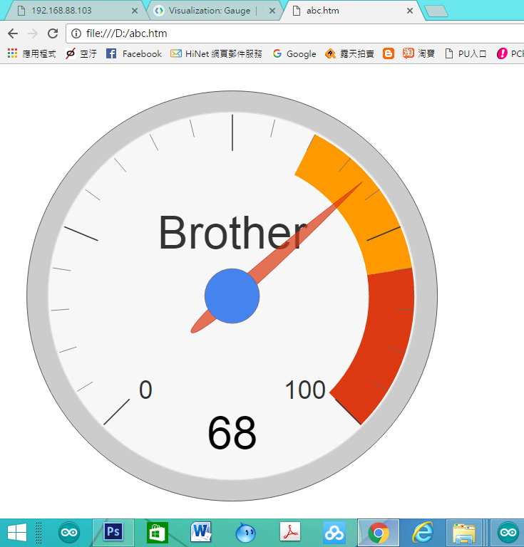
視覺化儀表板
2017/6/24
42

Slide 43
視覺化儀表板重點解說
<html>
<head>
<script type="text/javascript" src="https://www.gstatic.com/charts/loader.js"></script>
<script type="text/javascript">
google.charts.load('current', {'packages':['gauge']});
google.charts.setOnLoadCallback(drawChart);
使用Google 資源
載入Google Chart 資源
2017/6/24
43

Slide 44
視覺化儀表板重點解說
function drawChart() {
var data = google.visualization.arrayToDataTable([
['Label', 'Value'],
['Brother', 68]
]);
[‘Label’, ‘Value’]➔資料標題
第二列的[‘Brother’, 68] 為資料第一筆，
前面為資料名稱，後面資料內容
2017/6/24
44

Slide 45
視覺化儀表板重點解說
var options = {
width: 800, height: 800,
redFrom: 80, redTo: 100,
yellowFrom:60, yellowTo: 80,
minorTicks: 5
};
width: ， height 為 每一個Chart的寬與高
redFrom: 紅色區域開始, redTo:紅色區域結束
yellowFrom:黃色區域開始, yellowTo:黃色區域結束
minorTicks: 5 最小刻度
2017/6/24
45

Slide 46
視覺化儀表板重點解說
var chart = new google.visualization.Gauge(document.getElementById('chart_div'));
chart.draw(data, options);
var chart = new google.visualization.Gauge(document.getElementById(‘chart_div’))➔產生儀表板
chart.draw(data, options);➔畫出儀表板
2017/6/24
46

Slide 47
視覺化儀表板重點解說
<body>
<div id="chart_div" style="width: 800px; height: 800px;"></div>
</body>
<div id=“chart_div” style=“width: 800px; height: 800px;”></div>➔產生叫” chart_div”的 繪圖空間
width: 800px 繪圖空間寬度
height: 800px;繪圖空間高度
2017/6/24
47

Slide 48
視覺化儀表板 程式開發
2017/6/24
48

Slide 49
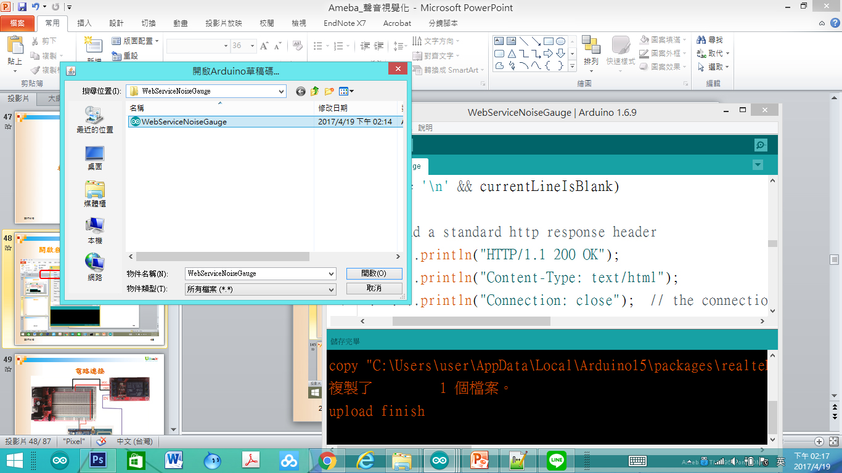
開啟程式WebServiceNoiseGauge
2017/6/24
49

Slide 50
程式WebServiceNoiseGauge
Serial.begin(9600); // initialize serial communication
// check for the presence of the shield:
if (WiFi.status() == WL_NO_SHIELD) {
Serial.println("WiFi shield not present");
while (true); // don't continue
}
2017/6/24
50
Notes:
#include <WiFi.h>
//char ssid[] = "BruceSonyC5"; // your network SSID (name)
//char pass[] = "12345678"; // your network password
char ssid[] = "IOT"; // your network SSID (name)
char pass[] = "iot12345"; // your network password
// your network password
int keyIndex = 0; // your network key Index number (needed only for WEP)
int status = WL_IDLE_STATUS;
WiFiServer server(80);
#define SoundPin 1
int SoundValue = 0;
int SoundValue1 = 0;
void setup() {
Serial.begin(9600); // initialize serial communication
// check for the presence of the shield:
if (WiFi.status() == WL_NO_SHIELD) {
Serial.println("WiFi shield not present");
while (true); // don't continue
}
String fv = WiFi.firmwareVersion();
if (fv != "1.1.0") {
Serial.println("Please upgrade the firmware");
}
// attempt to connect to Wifi network:
while (status != WL_CONNECTED) {
Serial.print("Attempting to connect to Network named: ");
Serial.println(ssid); // print the network name (SSID);
// Connect to WPA/WPA2 network. Change this line if using open or WEP network:
// status = WiFi.begin(ssid); //no pass
status = WiFi.begin(ssid, pass); //wpa use
// wait 10 seconds for connection:
delay(10000);
}
server.begin(); // start the web server on port 80
printWifiStatus(); // you're connected now, so print out the status
}
void loop() {
SoundValue = analogRead(SoundPin) ;
SoundValue1 = map(analogRead(SoundPin),0,1023,0,100) ;
// wifi code here
// listen for incoming clients
WiFiClient client = server.available();
if (client)
{
Serial.println("Now Someone Access WebServer");
Serial.println("new client");
// an http request ends with a blank line
boolean currentLineIsBlank = true;
while (client.connected())
{
if (client.available())
{
char c = client.read();
Serial.write(c);
// if you've gotten to the end of the line (received a newline
// character) and the line is blank, the http request has ended,
// so you can send a reply
if (c == '\n' && currentLineIsBlank)
{
// send a standard http response header
client.println("HTTP/1.1 200 OK");
client.println("Content-Type: text/html");
client.println("Connection: close"); // the connection will be closed after completion of the response
client.println("Refresh: 5"); // refresh the page automatically every 5 sec
client.println();
client.println("<!DOCTYPE HTML>");
client.println("<html>");
// output the value of each analog input pin
client.println("<head>");
client.println("<script type='text/javascript' src='https://www.gstatic.com/charts/loader.js'></script>");
client.println("<script type='text/javascript'>");
client.println("google.charts.load('current', {'packages':['gauge']});");
client.println("google.charts.setOnLoadCallback(drawChart);");
client.println(" function drawChart() {");
client.println("var data = google.visualization.arrayToDataTable([['Label', 'Value'],['Noise',");
client.println(SoundValue1);
client.println("],]);");
client.println(" var options = {width: 700, height: 700,redFrom: 90, redTo: 100,yellowFrom:75, yellowTo: 90,minorTicks: 5};");
client.println("var chart = new google.visualization.Gauge(document.getElementById('chart_div'));");
client.println("chart.draw(data, options);");
client.println("}");
client.println("</script>");
client.println("</head>");
client.println("<meta charset='utf-8'>");
client.println("<body>");
client.println("<div id='chart_div' style='width: 700px; height: 700px;'></div>");
client.println("</body>");
client.println("</html>");
break;
}
if (c == '\n')
{
// you're starting a new line
currentLineIsBlank = true;
} else if (c != '\r')
{
// you've gotten a character on the current line
currentLineIsBlank = false;
}
}
}
// give the web browser time to receive the data
delay(1);
// close the connection:
client.stop();
Serial.println("client disonnected");
}
delay(800) ;
}
void printWifiStatus() {
// print the SSID of the network you're attached to:
Serial.print("SSID: ");
Serial.println(WiFi.SSID());
// print your WiFi shield's IP address:
IPAddress ip = WiFi.localIP();
Serial.print("IP Address: ");
Serial.println(ip);
// print the received signal strength:
long rssi = WiFi.RSSI();
Serial.print("signal strength (RSSI):");
Serial.print(rssi);
Serial.println(" dBm");
// print where to go in a browser:
Serial.print("To see this page in action, open a browser to http://");
Serial.println(ip);
}

Slide 51
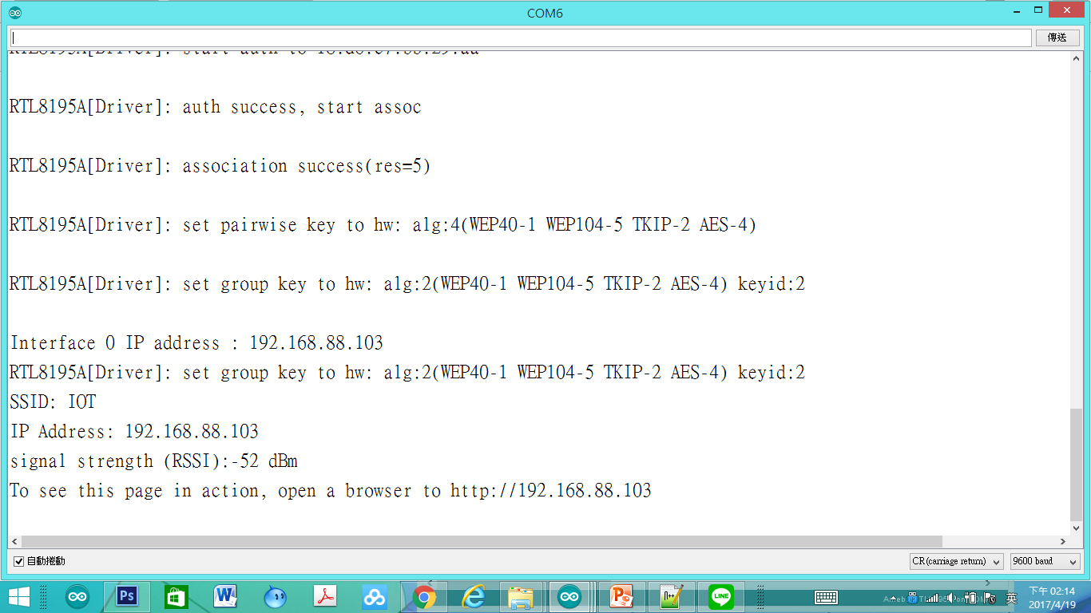
程式WebServiceNoiseGauge監控畫面
2017/6/24
51

Slide 52
使用瀏覽器進入系統
1.先使用筆電或手機，使用wifi，並將ＷＩＦＩ熱點連接到與Ameba相同的熱點
2.進入瀏覽器(建議使用chrome)
3.網址列輸入上面IP(本例子為：http://192.168.88.103/
2017/6/24
52

Slide 53
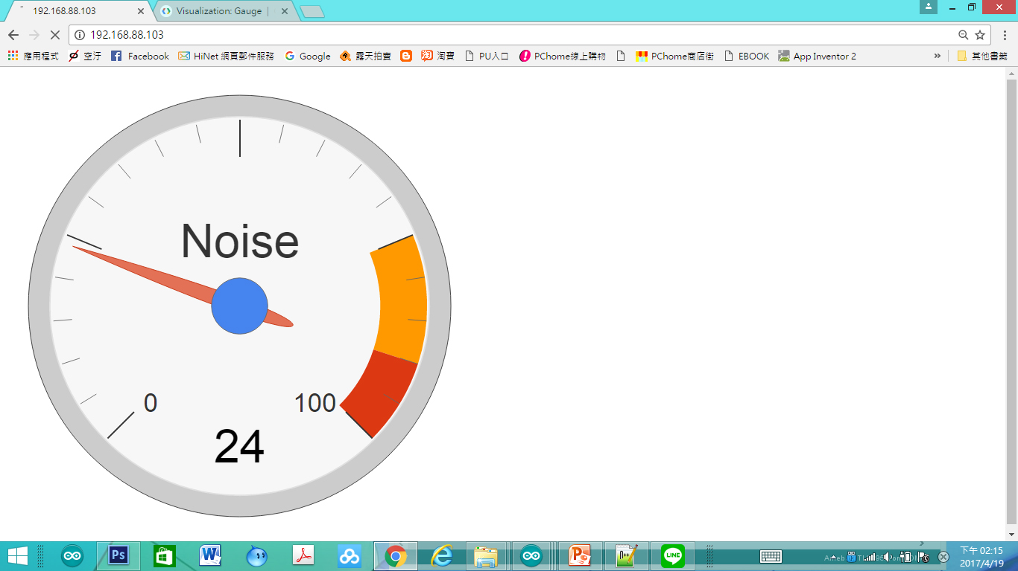
程式WebServiceNoiseGauge網頁畫面
2017/6/24
53

Slide 54
自我練習
2017/6/24
54

Slide 55
習題
請將讀取值(analog)範圍限制在0,100
Gauge 抬頭設為:SOUND”
黃色區域為55-80
紅色區域為80-100
2017/6/24
55

Slide 56
Q & A
感謝聆聽
恭請指教

